Slide 1


Slide 2

Healthcare analytics enables evidence-based decisions
Use of EHRs, administrative, and financial data improves system efficiency
Prior studies show analytics helps:
Improve patient outcomes
Optimize hospital resources
Reduce unnecessary costs
Literature supports a multidimensional analytics approach in healthcare
Literature Review

Slide 3
Patient Demographics & Risk Patterns
Clinical Indicators & Hospital Admissions
Economic & Operational Efficiency
Predictive Modeling & Machine Learning
Literature Review

Slide 4
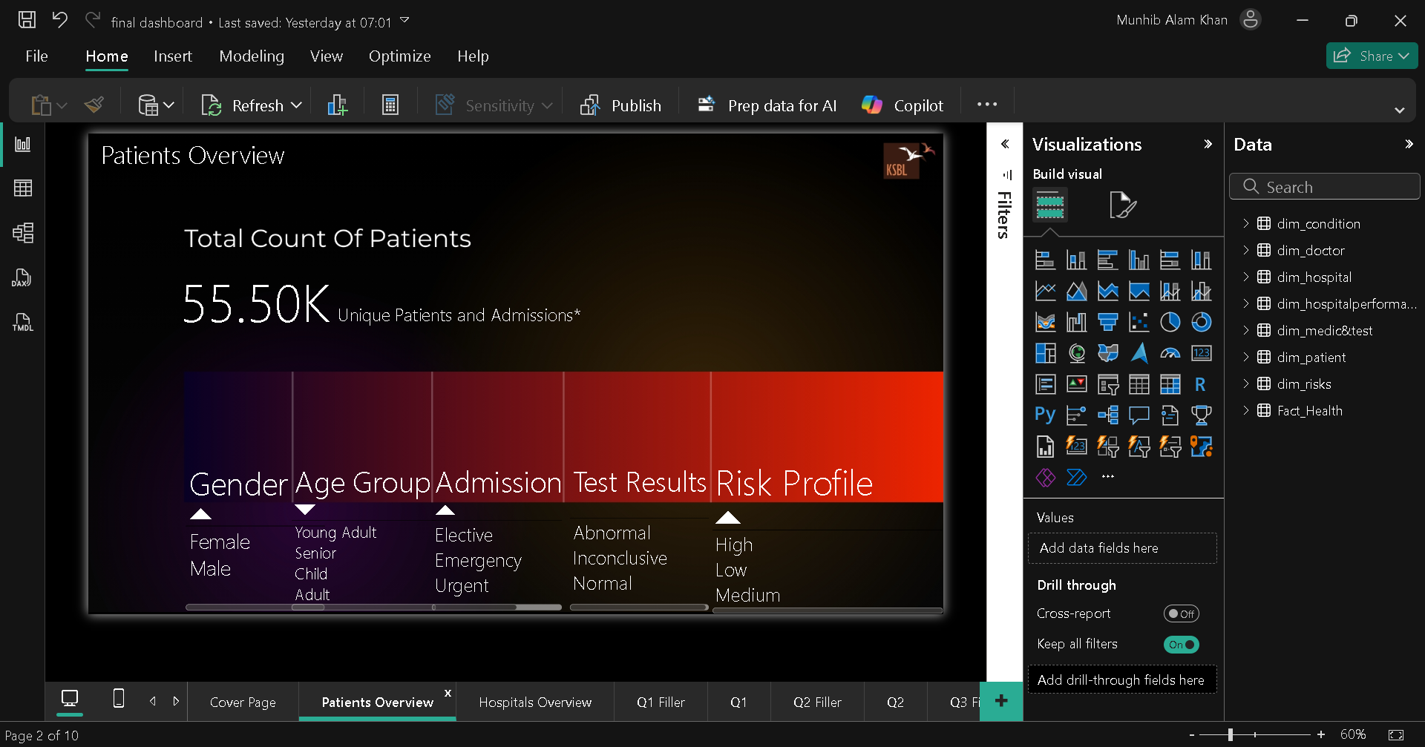

Slide 5
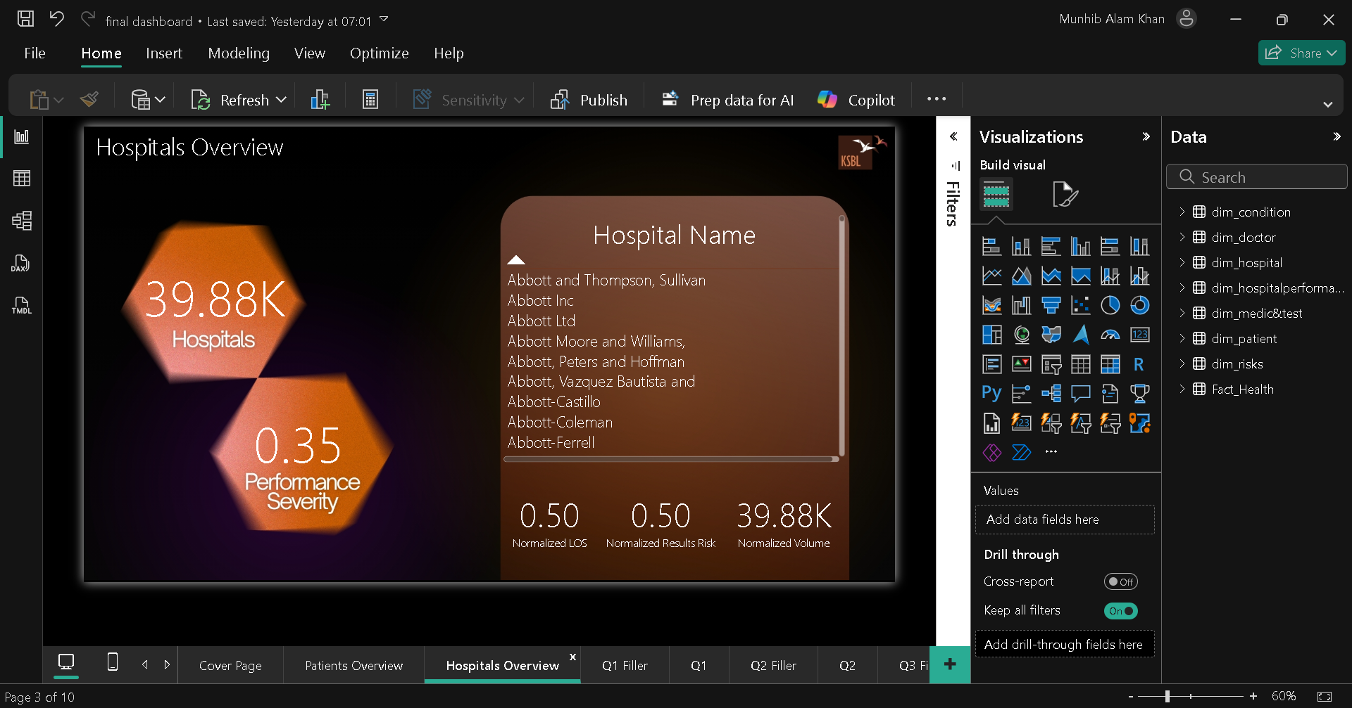

Slide 6
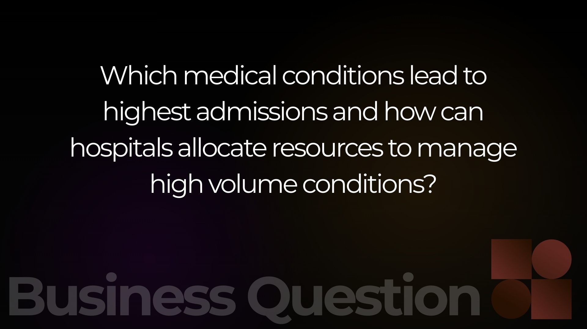

Slide 7
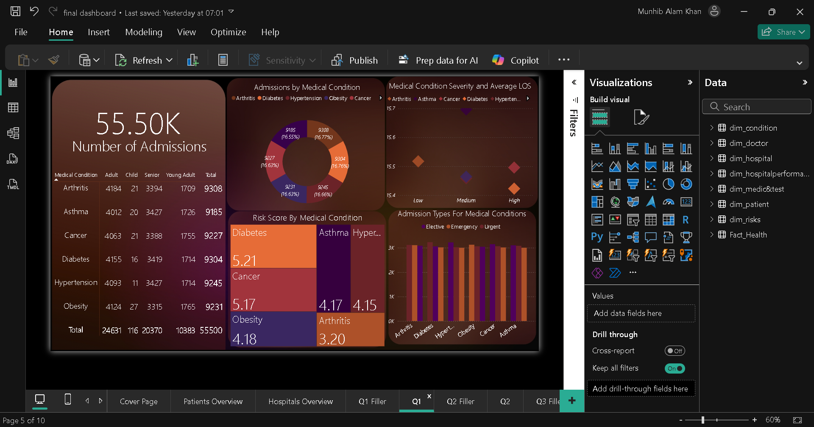

Slide 8
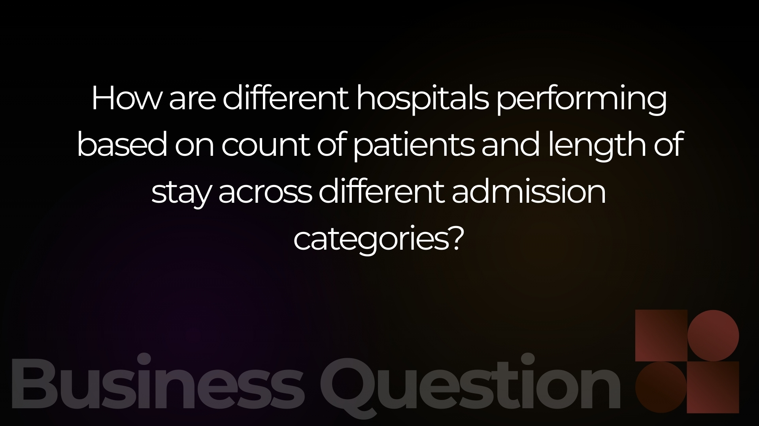

Slide 9
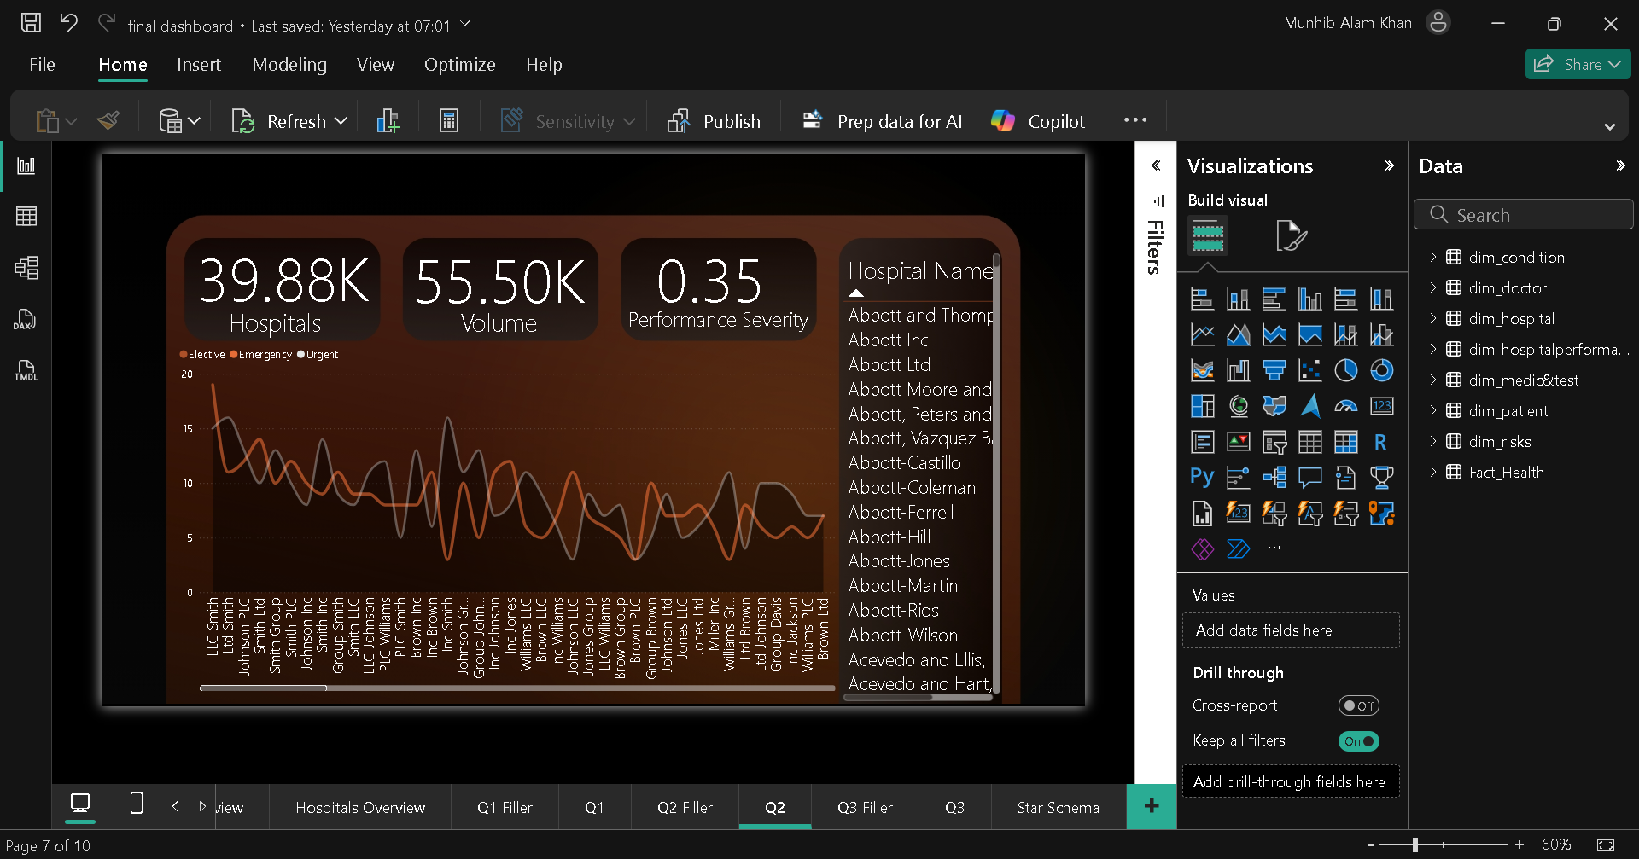

Slide 10
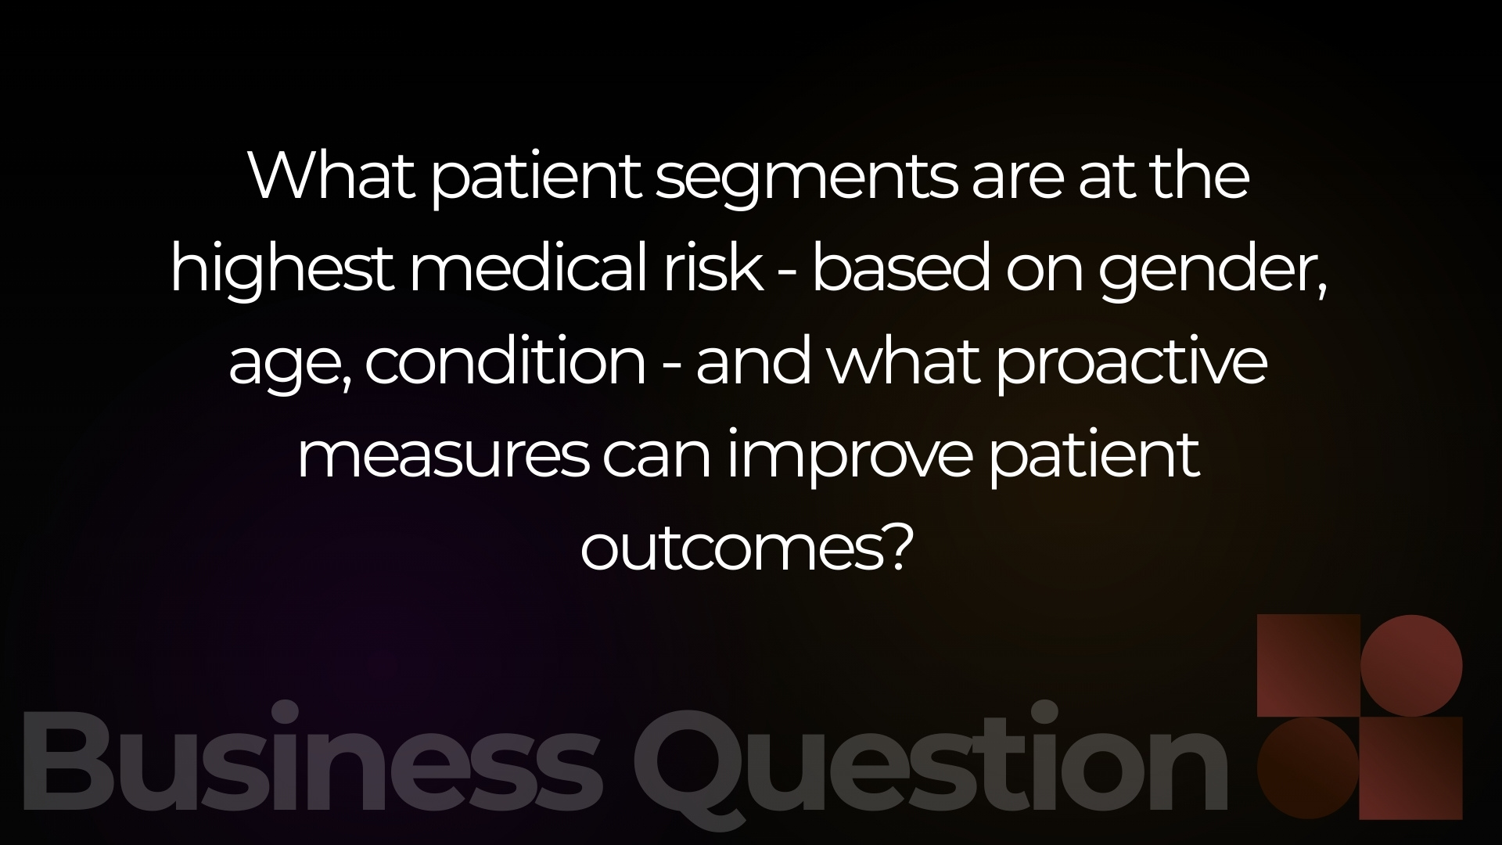

Slide 11
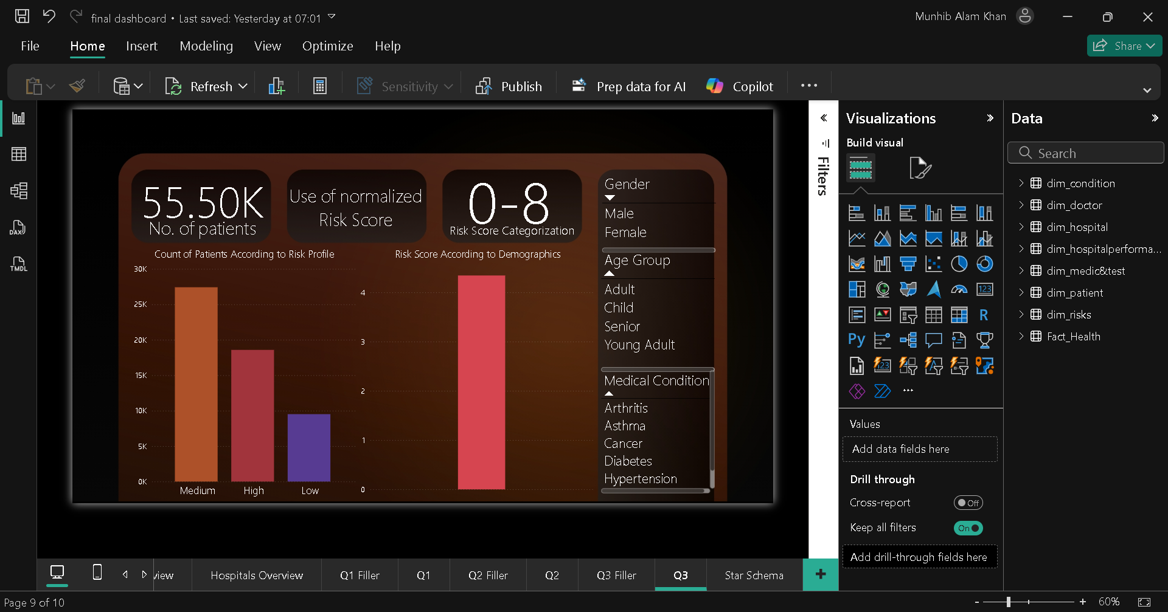

Slide 12
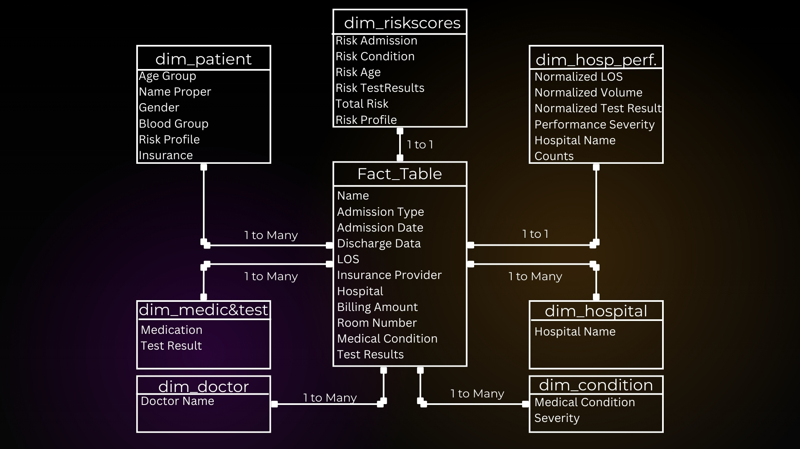

Slide 13

Q1
Dedicated Care Units
Create specialized wards or care teams for high-admission conditions (e.g., Diabetes, Hypertension, Cancer)
Assign condition-specific nurses and physicians
Resource Pre-Allocation
Pre-allocate beds, equipment, and medications for high-volume conditions
Stock frequently used drugs in advance to reduce delays
Recommendatios

Slide 14

Q1
Standardized Treatment Protocols
Implement condition-specific care pathways to reduce variation in treatment
Use clinical checklists to shorten decision time and reduce LOS
Preventive & Awareness Programs
Launch outpatient education programs (diet, lifestyle, medication adherence)
Conduct awareness campaigns to reduce avoidable hospital admissions
Recommendatios

Slide 15
Q2
Targeted Intervention by Health Ministry
Deploy audit teams to underperforming hospitals
Identify bottlenecks in:
Discharge planning
Staffing levels
Bed turnover rates
Staffing & Shift Rebalancing
Increase staff in wards with consistently high LOS
Adjust shift schedules during peak admission periods
Recommendatios

Slide 16
Q3
Risk-Based Patient Triage
Use risk scores at admission to flag high-risk patients
Prioritize these patients for early diagnostics and monitoring
High-Risk Patient Monitoring
Assign senior doctors or care coordinators to high-risk cases
Increase frequency of vital checks and follow-ups
Recommendatios

Slide 17
Q3
Proactive Care Plans
Develop personalized care pathways for:
Seniors
Adults with chronic diseases
Schedule post-discharge follow-ups to prevent readmissions
Community & Preventive Outreach
Partner with local clinics for chronic disease screening
Promote early diagnosis to shift emergency cases into elective admissions
Recommendatios

Slide 18
Healthcare analytics improves:
Decision-making
Resource allocation
Patient care planning
Dashboard functions as a:
Decision-support system, not just reporting
Integrating demographics, clinical, and operational data:
Enhances hospital performance
Supports sustainable healthcare operations
Conclusion

Slide 19
“Data does not save lives — decisions made from data do.”

